Slide 1
GO Team Business Meeting #2
Where we are – Where we’re going

Slide 2
Where We Are
Our strategic plan is the guide for the work we’re doing in the school. By monitoring the plan and ranking priorities, we can all work towards the common goals. Using the priorities in the strategic plan, the school leadership team developed a Continuous Improvement Plan (CIP) for the current school year.

Slide 3
Timeline for GO Teams
You are HERE
Fall 2021
GO Team Developed 2021-2025 Strategic Plan
1
Summer 2022
School Leadership completed Needs Assessment and defined overarching needs for SY22-23
2
August 2022
School Leadership completed 2022-2023 Continuous Improvement Plan
3
Sept. – Dec. 2022
Utilizing current data, the GO Team will review & possibly update the school strategic priorities and plan
4
Before Winter Break
GO Team will take action (vote) on the rank of the strategic plan priorities for SY23-24 in preparation for budget discussions.
5

Slide 4
Discussion Items
Current Strategic Plan
Continuous Improvement Plan
Needs Assessment
SMART GOALS
Action Plan
MAP Data
Data Protocol

Slide 5
Current Strategic Plan
2021-2025

Slide 6
School Name
Mission
Vision
SMART Goals
TBD
TBD
TBD
TBD
APS Strategic Priorities & Initiatives
School Strategic Priorities
School Strategies
1A. tbd
1B. tbd
1C. tbd
Fostering Academic Excellence for All Data
Curriculum & Instruction Signature Program
Before Presenting to your GO Team:
Insert School’s Current Strategic Plan
Building a Culture of Student Support
Whole Child & Intervention Personalized Learning
TBD: tbd
TBD: tbd
4.
Equipping & Empowering Leaders & Staff
Strategic Staff Support Equitable Resource Allocation
6.
7.
TBD: tbd
Creating a System of School Support
Strategic Staff Support
Equitable Resource Allocation
8.
9.
TBD: tbd
14

Slide 7
Mission
Cascade Elementary School
2024 Strategic Plan
Vision
To prepare students for life, college and careers by providing rigorous, equitable, culturally relevant
And real world learning experiences in order to become fully engaged and realized citizens of the
Global community.
To become the premier elementary school within Southwest
Atlanta that provides students with a broad and balanced education.
SMART Goals
Improve the proficiency rates of students in grades 3-5 by 6% in ELA by June 2024 on the GA Milestones
Improve the proficiency rates of students in grades 3-5 by 6% in Math by June 2024 on the GA Milestones
Improve family wellness survey question to exceed a 3.94 rating
TBD
APS Strategic Priorities
& Initiatives
School Strategic Priorities
School Strategies
Fostering Academic
Excellence for All
Data
Curriculum & Instruction
Signature Program
Improve the percent of students achieving at the proficient and distinguished levels on the GA Milestones
Improve Tier 1 instructional strategies in ELA & Mathematics
Improve early identification procedures for Tier 2 and above
a; School wide implementation of Fundations, Lucy Calkins, and Eureka Math
b; Provide professional learning sessions focused on curricular programs
2. Conduct weekly data meetings and rehearsals focused on tier 1 content
3. Retain an intervention specialist to oversee protocols and instruction for Tier 2 and above
Building a Culture of
Student Support
Whole Child & Intervention Personalized Learning
4. Become an authorized IB PYP World School by 2023
5. Continue to implement a Tier 1 intervention block for ELA & Math
4. Conduct professional learning sessions designed to increase program awareness and philosophies
5. Observe and monitor the implementation of Tier 1 instructional block
Equipping & Empowering
Leaders & Staff
Strategic Staff Support
Equitable Resource Allocation
6. Build teacher capacity using effective instructional coaching strategies
7. Increase the amount of certifications and endorsements among staff
6. Retain a Turn Around Reading Specialist and Math Master Teacher Leader to support teachers with instructional strategies
7. Promote certification and endorsement opportunities in staff communications
Creating a System of School Support
Strategic Staff Support
Equitable Resource Allocation
8. Create a positive healthy school environment where students thrive, teachers enjoy coming to work, and the community trusts
8. Conduct weekly house meetings and monthly events for families to engage in

Slide 8
Continuous Improvement Plan
SY 2022-2023

Slide 9
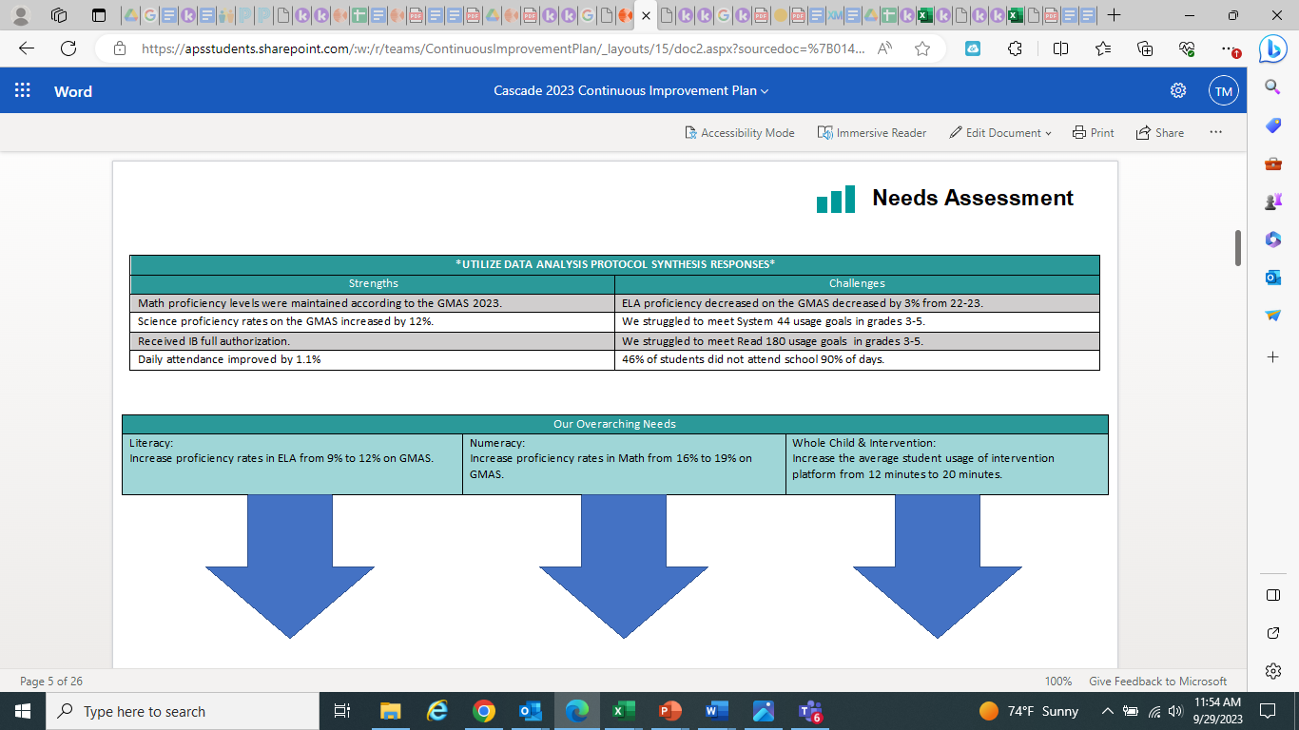
School Name
Needs Assessment
Strengths | Opportunities/Challenges
Before Presenting to
your GO Team:
Insert Your Needs Assessment
(use as many slides as necessary)
Our Overarching Needs
Literacy: | Numeracy: | Whole Child & Student Support
Jamboard Link Here
Literacy Problem Statement | Numeracy Problem Statement | Whole Child & Student Support Problem Statement
Notes:
Notes for School CIP Teams: After completing your Comprehensive Needs Assessment ( data protocol), you will come here and identify some strengths and opportunities/challenges you have observed from the data. The priority areas are Literacy, Numeracy, and Whole Child & Student Support. Identify an overarching need for each area. Formulate a problem statement for each area. Make sure the problem statement meets the criteria. Refer to your CIP resources.

Slide 10
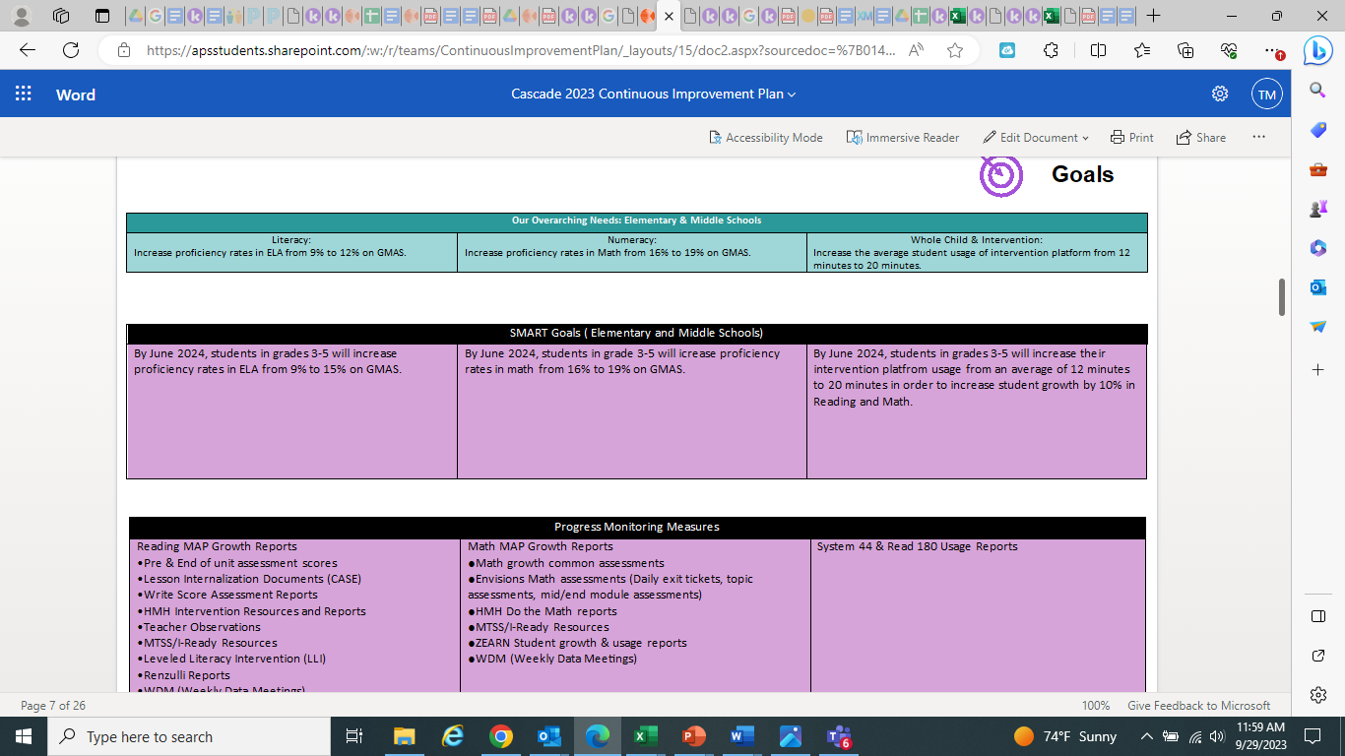
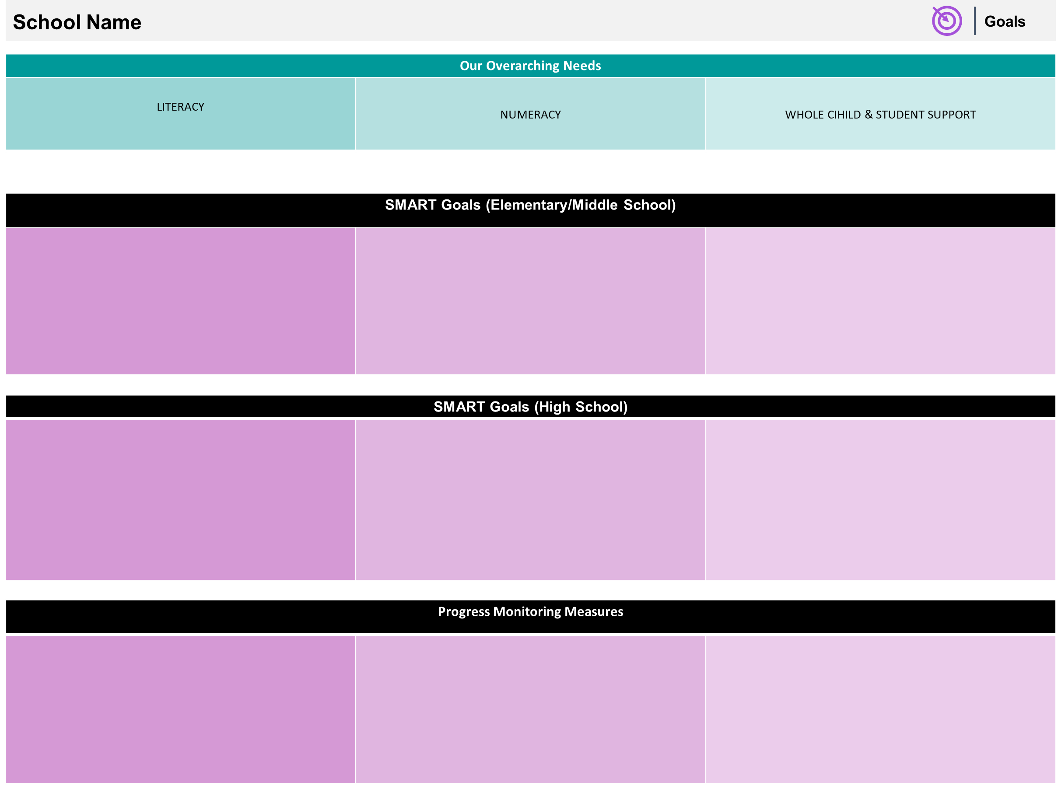
Before Presenting to
your GO Team:
Insert Your Overarching Needs and SMART Goals
(use as many slides as necessary)

Slide 11
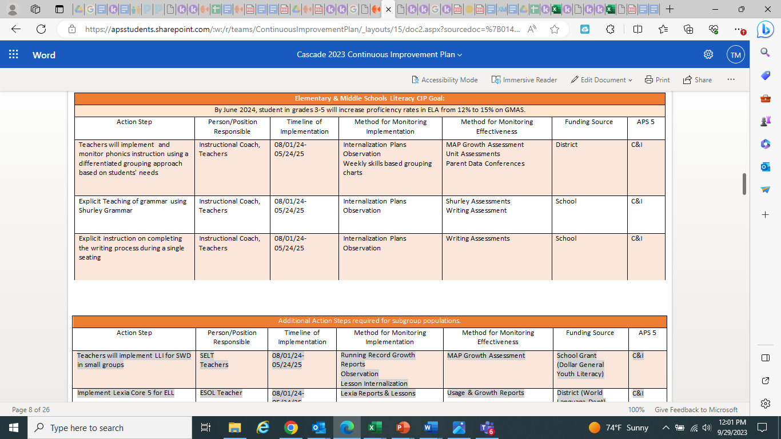
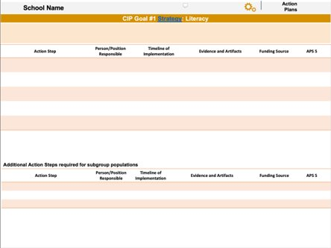
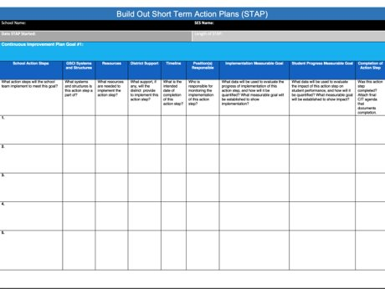
Before Presenting to
your GO Team:
Insert Your Action Plan
(use appropriate format)

Slide 12
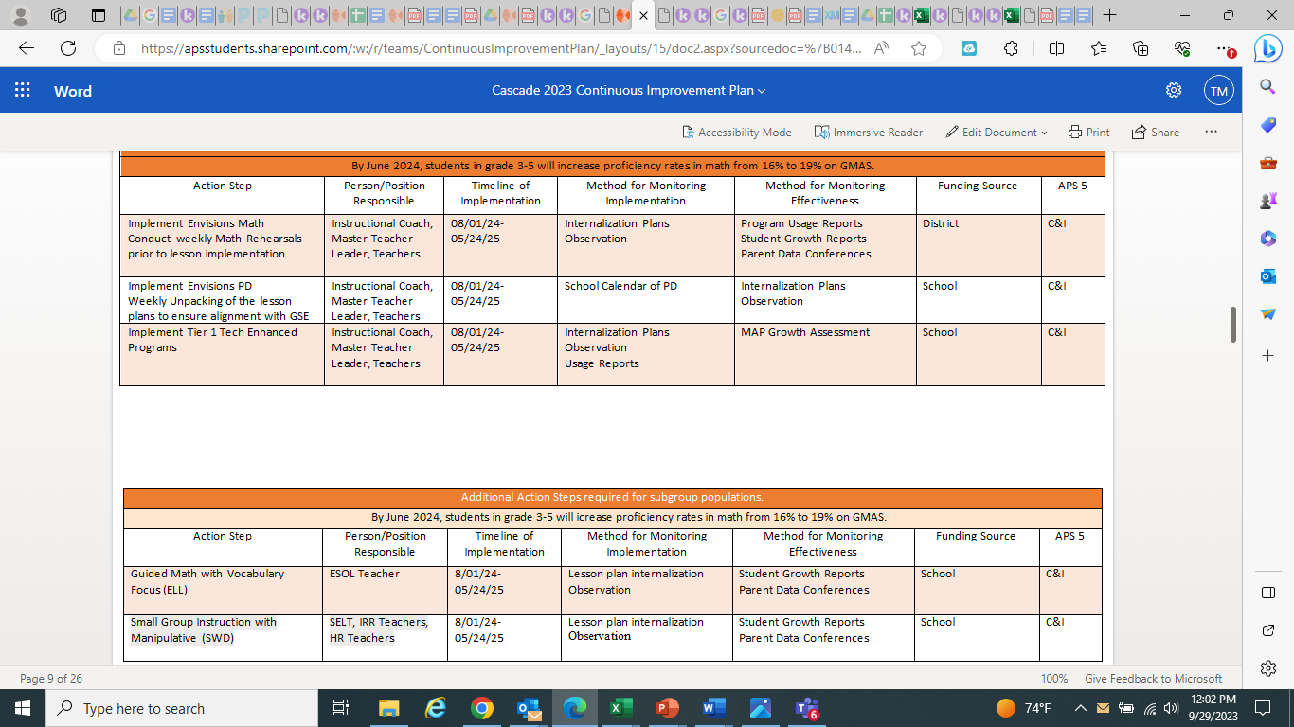

Slide 13
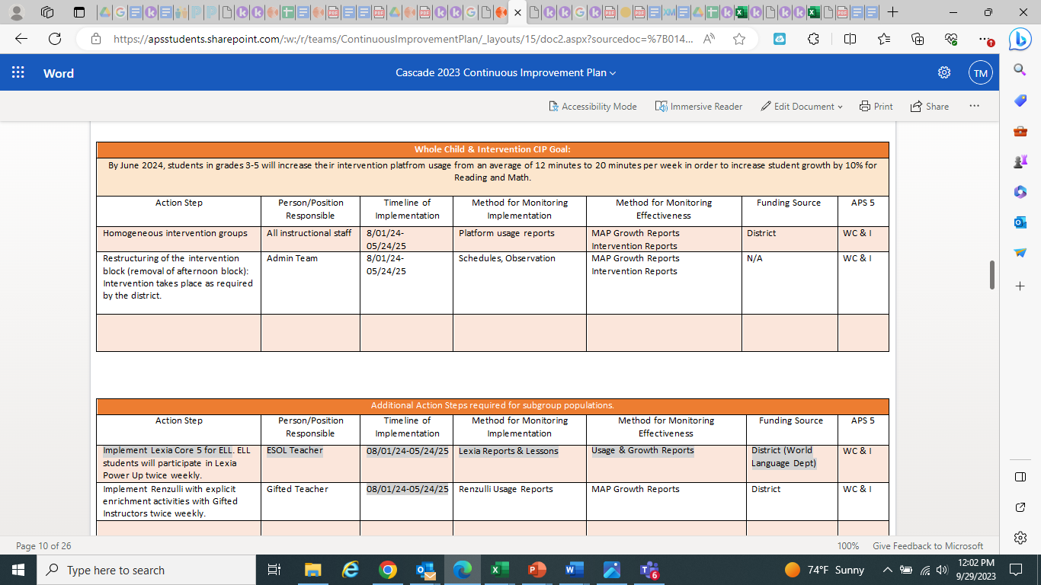

Slide 14
GO Team Activity & Discussion
GO TEAM DISCUSSION: Review the priorities and goals in your strategic plan and the information and goals CIP. Reflect on if updates need to be made to the Strategic Plan.
Are all CIP Goals reflected in
our Strategic Plan Priorities?
If not, which CIP Goal(s) are missing and should be added to the Strategic Plan?

Slide 15
MAP Data
1st Administration

Slide 16
Spring MAP Results
Grade Level | 2023 ELA | 2023 Math | Cohort ELA | Cohort Math
Kindergarten | 53% | 30%
First | 10% | 12% | 53% | 30%
Second | 14% | 13% | 10% | 12%
Third | 6% (GMAS) | 14% (GMAS) | 17% | 12%
Fourth | 10% (GMAS) | 21% (GMAS) | 6% (GMAS) | 14% (GMAS)
Fifth | 12% (GMAS) | 14% (GMAS) | 10% (GMAS) | 21% (GMAS)
Fifth Grade | 2023 Sci | 12% (GMAS)

Slide 17
Fall MAP Results
Before Presenting to your GO Team:
Insert School’s 2023 Fall MAP Results – use as many slides as necessary

Slide 18
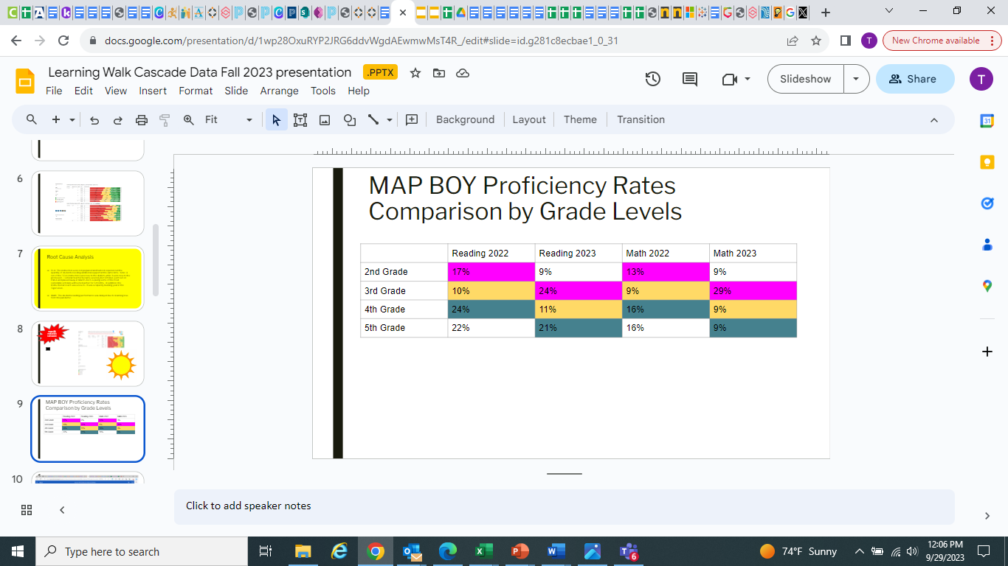

Slide 19
GO Team Discussion: Data Protocol
What do you notice?
What are your wonderings?
What additional questions do you have?

Slide 20
Strategic planning will help you fully uncover your available options, set priorities for them, and define the methods to achieve them.
Robert J. Mckain

Slide 21
Where we’re going
At our next meeting(s) we will discuss how our data is aligning to our strategic plan and determine if we need to make any adjustments.
Before the end of Fall Semester, we will take Action (vote) on ranking our strategic priorities for the 2024-2025 school year.
Let me or the Chair know of any additional information you need for our future discussion.

Slide 22
Thank you

